Slide 1

WEYLAND ENERGY
Building Harrow Bay: lessons from year one
North Sea Energy Summit 2026 · Hamburg · Elena Márquez

Slide 2
Harrow Bay in numbers
480
1.9
520,000
2028
MW – 40 × 12 MW turbines
TWh per year
homes equivalent
commercial operation
WEYLAND ENERGY · Building Harrow Bay – lessons from year one
2

Slide 3
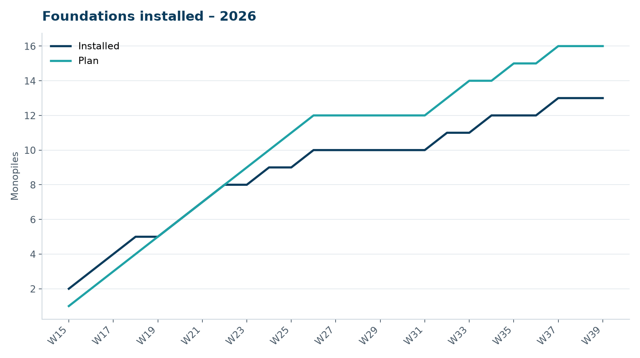
Where we are
• Construction start 7 April 2026
• Offshore substation topside installed 19 August
• Foundations: weather, weather, weather
WEYLAND ENERGY · Building Harrow Bay – lessons from year one
3
Notes:
Don't go into the exact numbers vs. baseline – public audience. Say 'a stormy September'.

Slide 4
Lessons – TODO
• noise
• safety
• cable?? (can I say this publicly – ask Noah/Priya)
WEYLAND ENERGY · Building Harrow Bay – lessons from year one
4

Slide 5
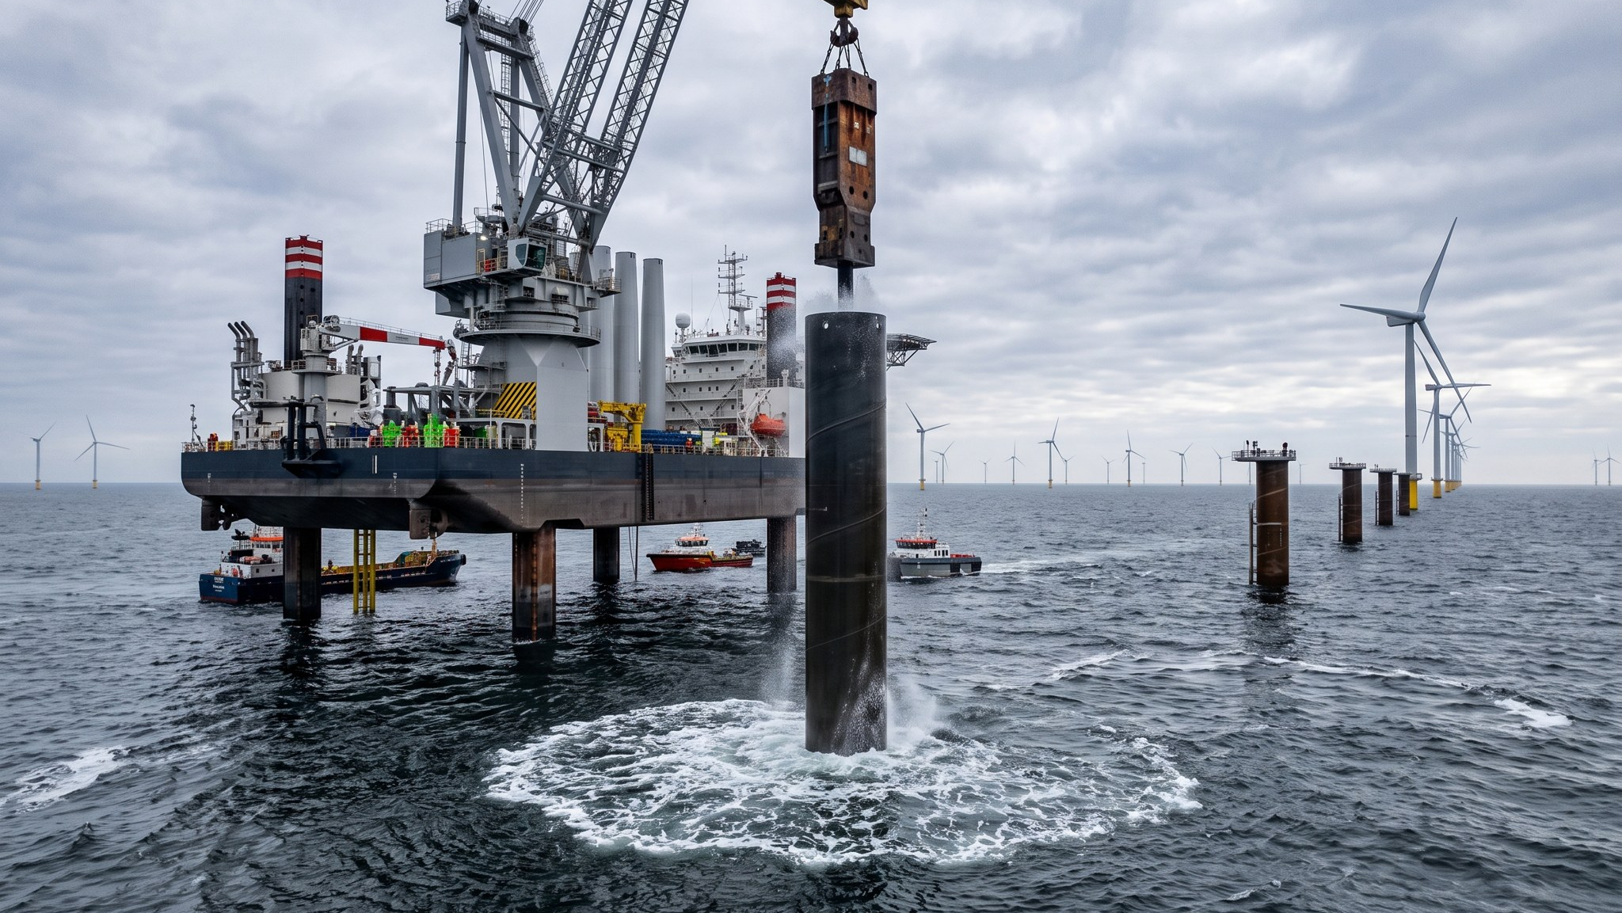
WEYLAND ENERGY
Thank you
elena.marquez@weyland-energy.example

